Slide 1



Diagnosis of Spinal Cord Injury
Cairo University
Faculty of Computers and Artificial Intelligence
Department of Computing and Bioinformatics
Supervised by
Dr. Ahmed Farouk
Dr. Sabah Sayed
TA. Sarah Ahmed
Implemented by

Slide 2
Agenda
Introduction
Background
Motivation
Problem Definition
Objective
Related Works
Materials and Methods
Results
System Analysis and Design
Demo
Time Plan
Conclusions

Slide 3

Introduction
Spinal Cord Injury
SCI Detection
Gene Expression Levels
Machine Learning

Slide 4

Background
The Spinal Cord (SC) is a major pathway for motor and sensory signals between the brain and the peripheral nervous system.
Spinal Cord Injury (SCI) occurs when the spinal tracts that convey sensory, motor, and autonomic signals between the brain and organs are disrupted.
SCI may cause patients to become paralyzed or stop organs from functioning properly.

Slide 5
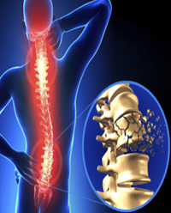
Motivation
Spinal cord injury is a serious condition that can result in permanent disability and a significant decrease in quality of life.
It may include partial or complete loss of sensory function or motor control of arms, legs, and/or body.
SCI may stop organs from functioning properly.
Currently, there is no cure for SCI.
Treatment options are limited to managing symptoms and preventing further damage to the spinal cord.
Early detection of SCI can help avoid further damage and improve outcomes.

Slide 6
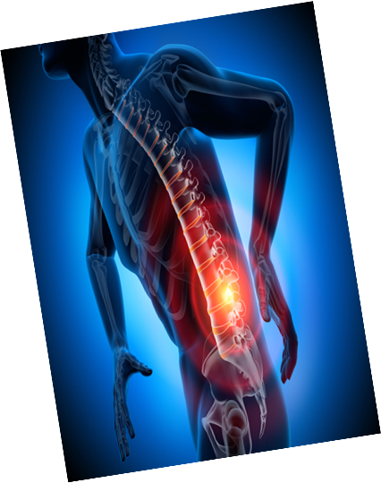
Problem Definition
This research is about identifying of hub genes related to the innate immune response activated during spinal cord injury
If certain genes appeared at certain expression level that could be a biomarker that this case is elevating to traumatic injury or is getting better or vice versa.
Certain gene expression levels might be a signal for a certain medical operation or treatment.
Studies that use machine learning to detect non-traumatic SCI are very rare and their results may be improved.

Slide 7
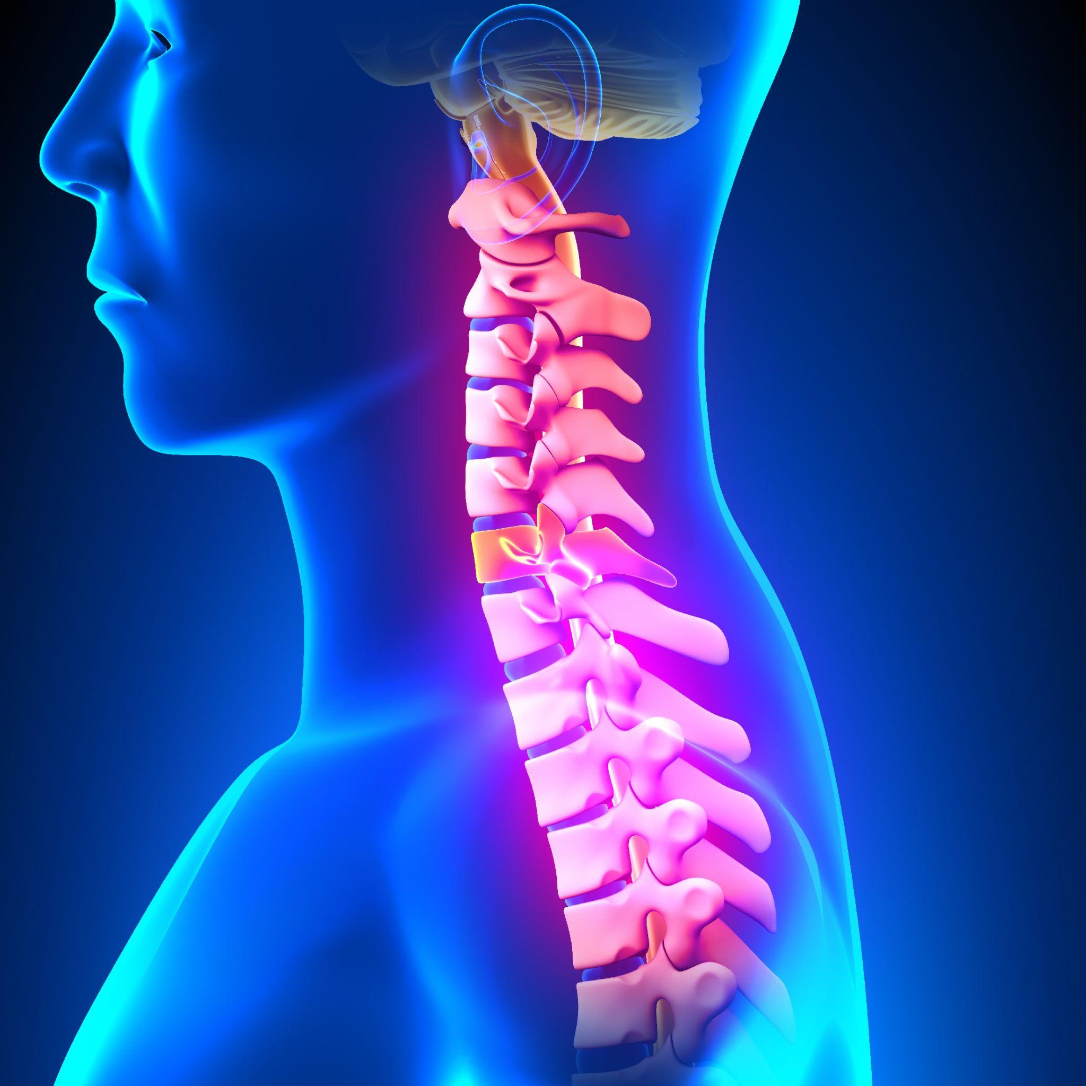
Project Objective
Conducting research on early detection of non-traumatic SCI using machine learning models.
Building and evaluating several machine learning models to detect SCI from gene expression data.
Developing a prognostic tool in the form of a web application that can predict SCI by identifying and analyzing genes that affect it.

Slide 8
Project Development Methodology
Planning phase (Waterfall)
Research and data preparation phase (Agile)
1
2
We used the "Waterfall" methodology in developing the web application and "Agile" methodology in the model building process in this project that uses machine learning for classifying spinal cord injury. This can help ensure the project is well-planned, efficiently executed, and successful in meeting the project objective .
Model training and testing phase (Agile)
Website implementation phase (Waterfall)
3
4

Slide 9
Related Works

Slide 10
A microarray gene chip approach was used to analyze global gene expression of the acute, subacute, and chronic stages of a moderate to severe injury to the rat spinal cord.
The goal of the analysis was to gain a better understanding of the gene expression changes that occur during different stages of spinal cord injury in rats.
{1} Spinal cord injury in rats

Slide 11
In another study on humans, the authors stated that they reached images from Kaggle but they were not labeled and, so the aim was to detect the region of interest in spinal cord injury instead of SCI classification.
One study published in the journal “Scientific Reports” utilized a machine learning approach to identify gene expression patterns associated with SCI.
Another study was published in the journal “BMC Bioinformatics”, which utilized a machine learning approach to predict the outcome of SCI based on gene expression data.
{2} Spinal cord injury in humans

Slide 12
This project aims to develop a predictive model and a diagnostic tool for SCI in humans
1
Some of the related works use data analysis techniques such as RNA sequencing and microarray data analysis.
2
This study is working with human data, specifically on the gene level.
A variety of machine learning algorithms have not yet been applied to this dataset.
3
The Main Differences

Slide 13
Materials and Methods

Slide 14
Dataset
The GSE151371 ribonucleic acid (RNA) -sequencing dataset contains blood RNA biomarkers for spinal cord injury.
It consists of a normalized gene expression matrix for humans, comprising 17,501 genes and 58 sequenced samples.
Out of the 58 samples, 10 samples were obtained from healthy individuals, 10 samples were obtained from non-CNS trauma patients, and 38 samples were obtained from individuals who had suffered a traumatic spinal cord injury.

Slide 15
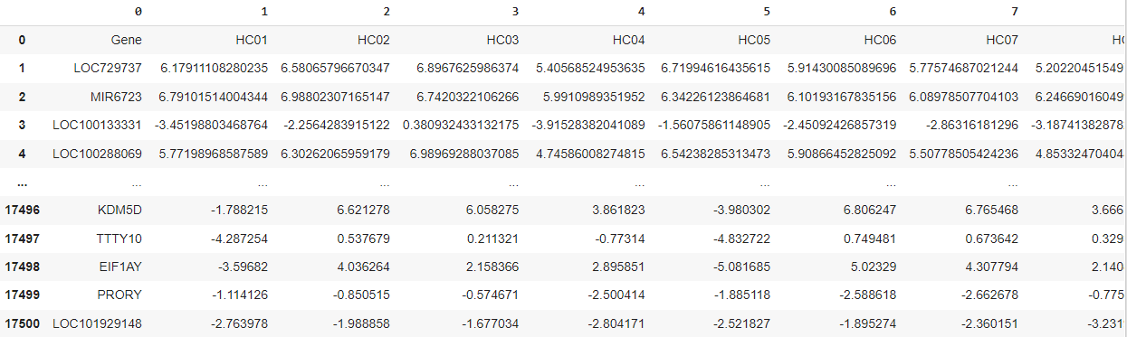
Normalized Gene Expression Matrix

Slide 16
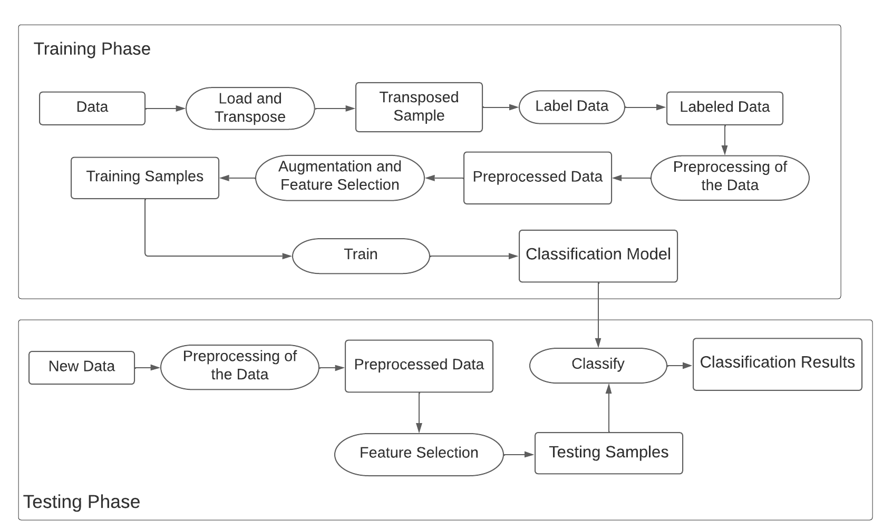
Pipeline

Slide 17
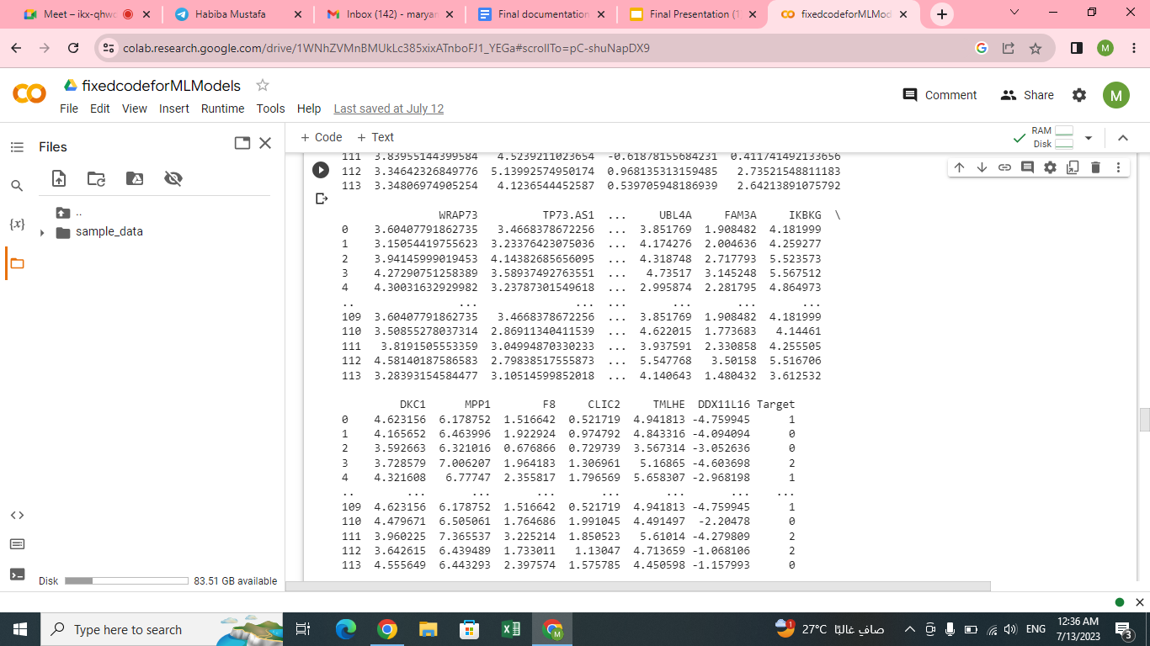
Dataset after the preprocessing

Slide 18
Standard Preprocessing Techniques
Normalization
Scaling the data so that all features have a similar range of values.
Shuffling
Randomizing the order of the samples in the dataset.
Label Encoding
Converting categorical labels into numerical values.
1
2
3

Slide 19
Augmentation
Minority/Majority Resampling
Replicating samples from the minority class (class 0, class 1 )to balance the class distribution in the dataset.
so wach class was represented in 38 rows
which increased the dataset into 114 sample instead of 58.
SMOTE
Generating synthetic samples from the minority class by interpolating between existing samples.
1
2

Slide 20
Feature Selection
Select From Model
Most important features are selected based on a user-defined threshold.
Variance Threshold
Removing features with low variance.
Chi-Square
Scaling has been applied to transfer our data to pos values.
The most important 1000 genes has been selected .
1
2
3

Slide 21
Models Training and Testing
Logistic regression
Support vector machine (SVM)
Decision tree (DT)
1
2
3
Naive Bayes
k-nearest neighbors (kNN)
Neural networks (NN)
4
5
6

Slide 22
Results

Slide 23
Results of a Sample of Our Experiments
Model | Accuracy without feature selection or Augmenting or scaling | Accuracy with Chi-Square & resampling minority | Accuracy with Chi-Square & SMOTE | Accuracy with SelectFromModel & over_sampling | Accuracy with SelectFromModel & SMOTE | Accuracy with VarianceThreshold & over_sampling | Accuracy with VarianceThreshold & SMOTE
Logistic regression | 83.33% | 85.71% | 85.71% | 83.33% | 83.33% | 83.33% | 83.33%
SVM | 83.33% | 85.71% | 85.71% | 83.33% | 83.33% | 83.33% | 83.33%
Decision tree | 66.66% | 82.85% | 80% | 66.66% | 77.77% | 72.22% | 72.22%
Gaussian Naive Bayes | 66.66% | 82.85% | 65.71% | 72.22% | 72.22% | 72.22% | 72.22%
Bernoulli Naive Bayes | 55.55% | 85.71% | 77.14% | 55.55% | 55.55% | 55.55% | 55.55%
KNN (k=7) | 55.55% | 71.42% | 77.14% | 72.22% | 72.22% | 72.22% | 72.22%
NN | 16.66% | 40% | 40% | 40% | 40% | 40% | 40%

Slide 24
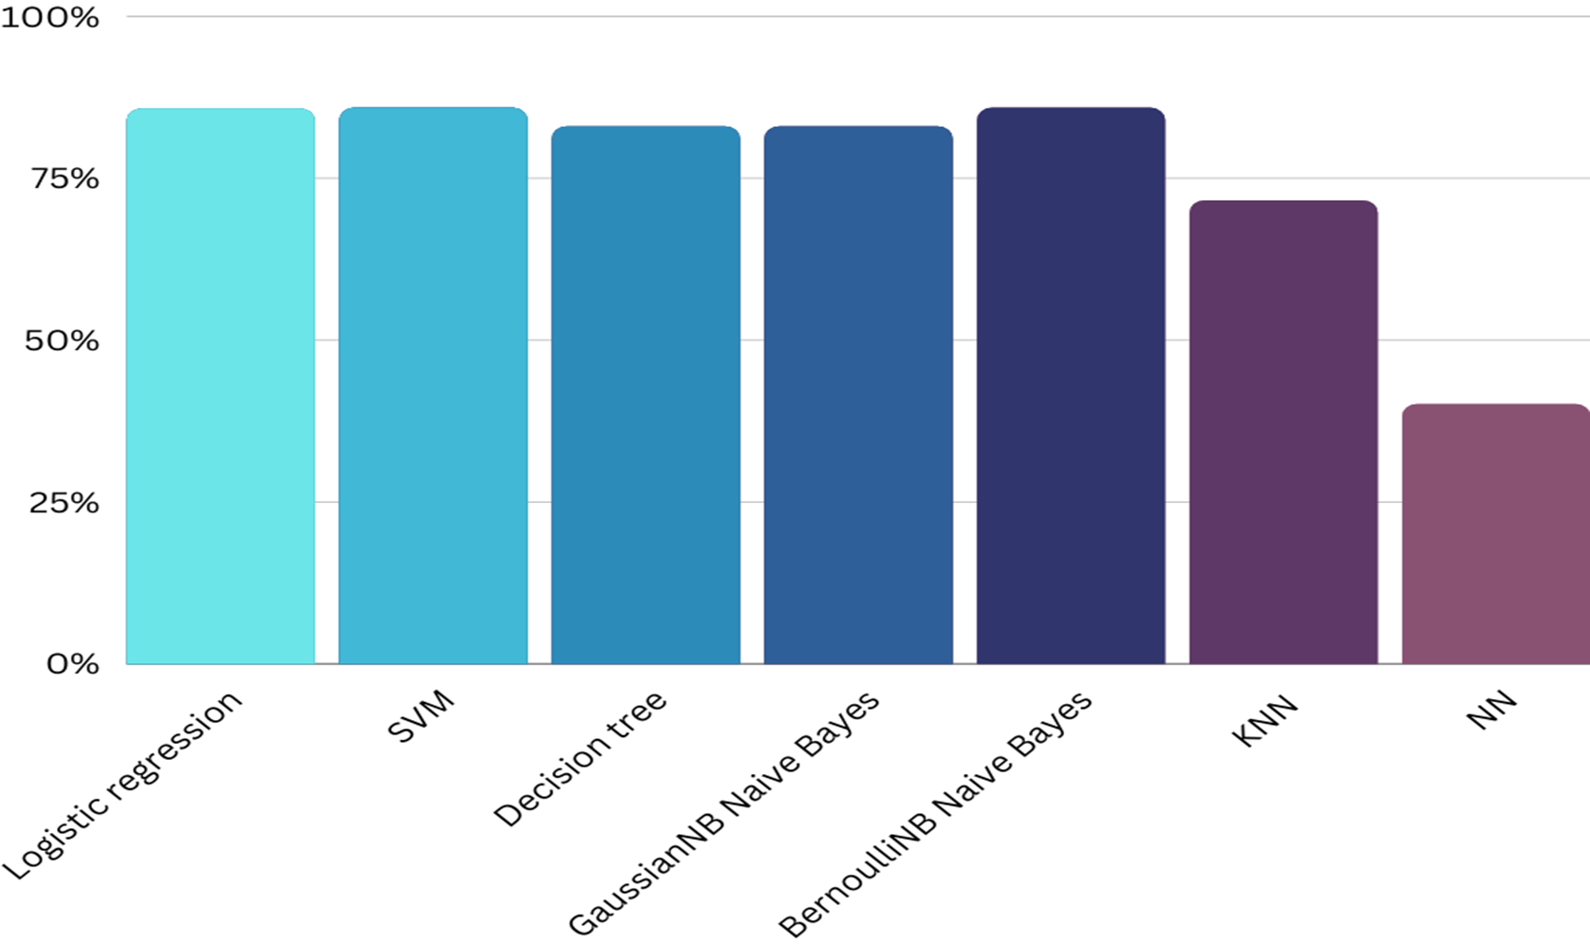


Results (continued)
Highest Performing Models | Accuracy | Precession | Recall
Logistic Regression | 85.71% | 87% | 85%
SVM | 85.71% | 87% | 85%
Bernoulli NB | 85.71% | 62% | 86%

Slide 25
System Analysis
and Design

Slide 26
Functional
Requirements
The web app system allows users to:
Sign up
Sign in
Log out
Upload a gene expression file
Get spinal cord injury detection results using the best-performing model from our research
Save the results file to the database
View history files
View analysis results
View contact info
Display app info

Slide 27




Non-Functional Requirements
Usability
Response Time
Robustness
Security
Reliability

Slide 28
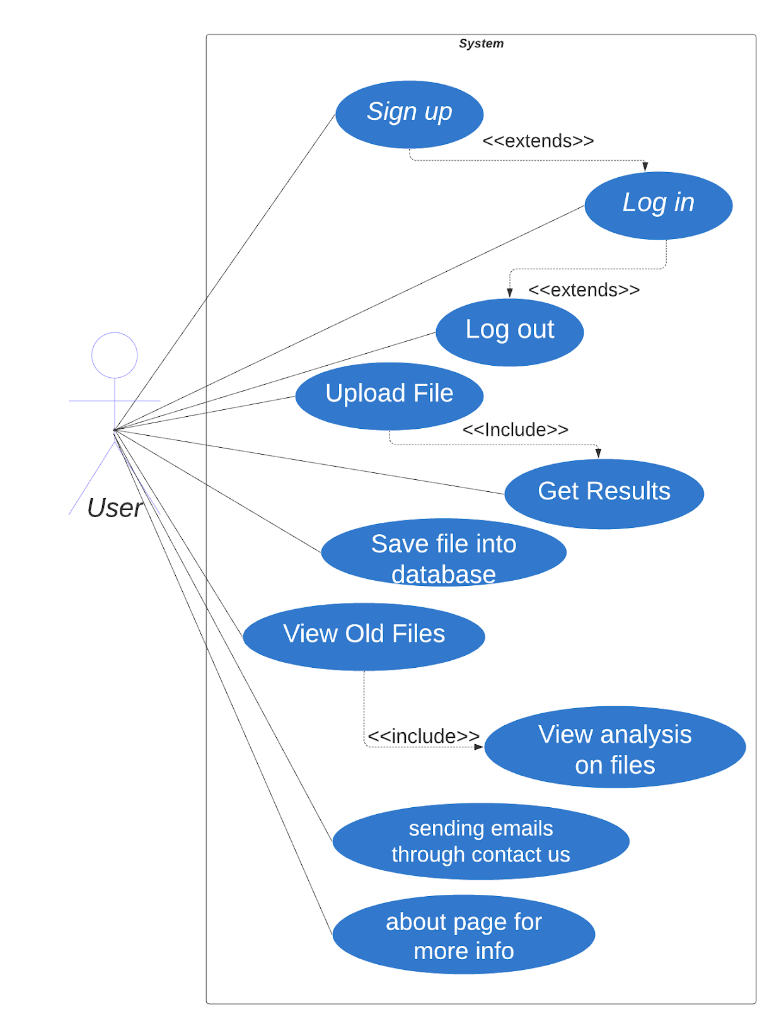
Use Case Diagram

Slide 29
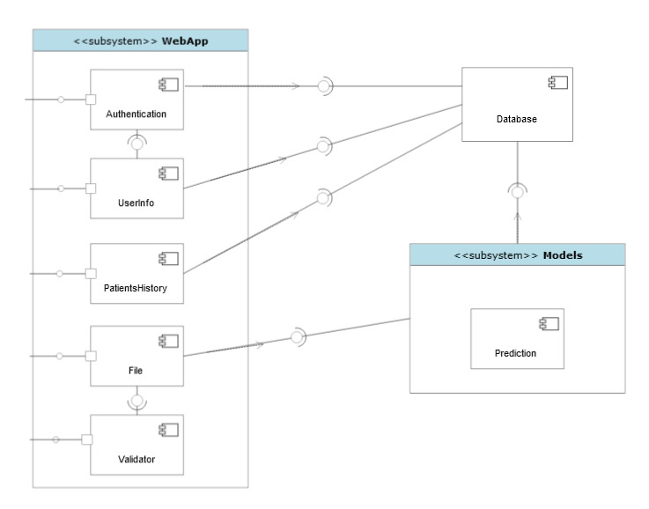
System Component Diagram

Slide 30
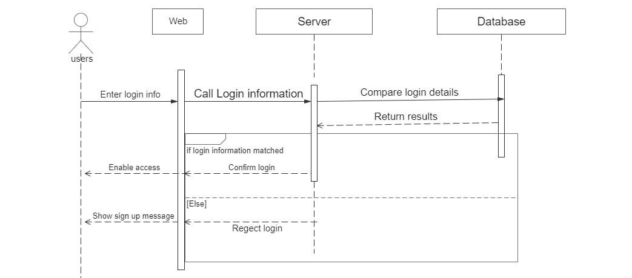
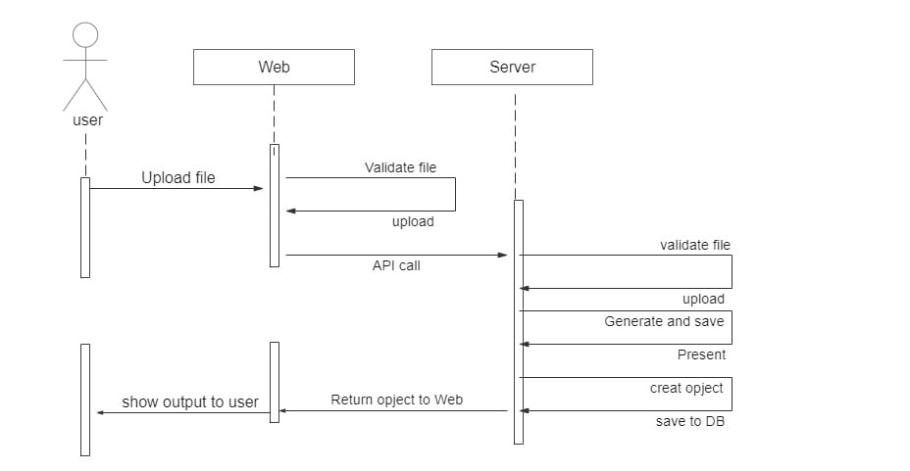
Sequence Diagram

Slide 31
Demo

Slide 32


Slide 33
Time Plan

Slide 34
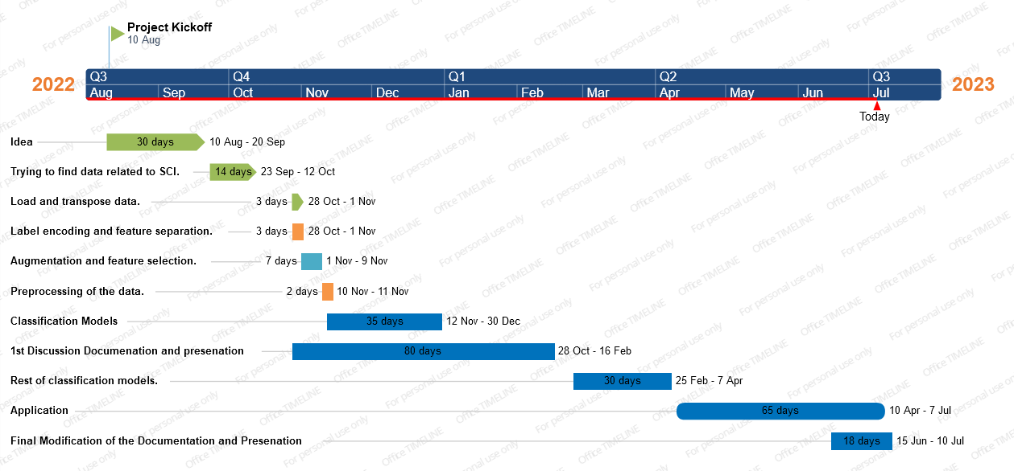
Gantt Chart

Slide 35

Conclusions
Machine learning algorithms showed a promising prediction of SCI from gene expression data.
Various machine learning algorithms, such as logistic regression, SVM and NB, were used in this research and their results were reported.
Logistic regression with chi-square feature selection and resampling data augmentation achieved the highest accuracy of 85.71% on the test data.
Feature selection and data augmentation were found to be extremely important for achieving a high accuracy on this dataset by classification models in general.

Slide 36
Conclusions
The study highlights the potential of machine learning algorithms for improving the detection and diagnosis of SCI using gene expression data.
A web application was built to deploy the most accurate models for use by neurologists in SCI diagnosis.

Slide 37

Thanks!

